Slide 1
Developer’s Blog

Slide 2
Introduction
In the ever-evolving world of technology, staying ahead requires constant learning, sharing, and collaboration. At developer’s blog, we bring together a community of passionate developers, programmers, and tech enthusiasts to create, share, and explore content that drives innovation and knowledge in the development field.
Whether you’re a seasoned coder or just stating your journey, our platform is designed to be your go-to resource for insightful articles, tutorials, and discussions on all things development. From front-end design to backend architecture, from coding best practices to the latest in tech trends, Developer’s blog offers a space where you can both learn and contribute to the broader tech community.
Join us in creating a thriving ecosystem of knowledge where every blog post is a step towards mastering your craft and inspiring others. Dive in, share your expertise, and stay connected with the latest developments in the world of technology.

Slide 3
Objective
1. Knowledge Sharing:
Objective: Share expertise, tips, tutorials, and best practices with the developer community.
Motive: Contribute to the growth of the community, help others solve problems, and establish oneself as a knowledgeable resource.
2. Personal Branding:
Objective: Build a personal brand and establish authority in a specific domain (e.g., web development, data science).
Motive: Increase visibility in the industry, attract job opportunities, and enhance professional reputation.
3. Learning and Growth:
Objective: Solidify understanding of new technologies, tools, and methodologies by writing about them.
Motive: Enhance one's own learning process, stay up-to-date with industry trends, and challenge oneself to explore new areas.

Slide 4
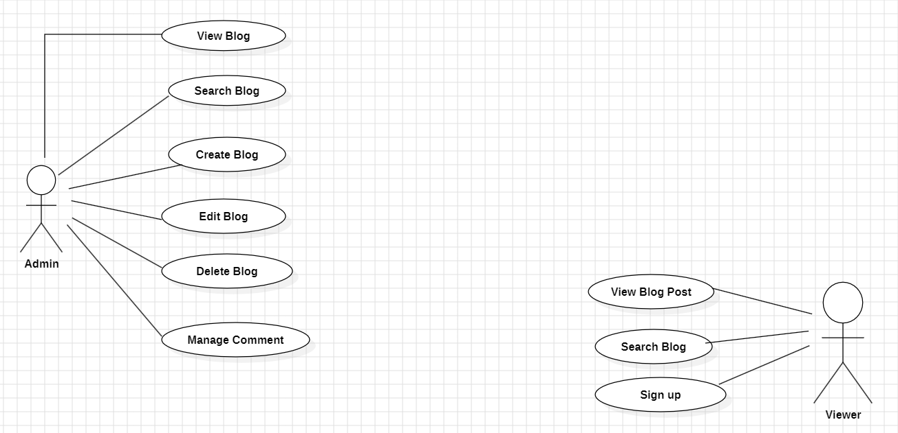
Use Case Diagram

Slide 5
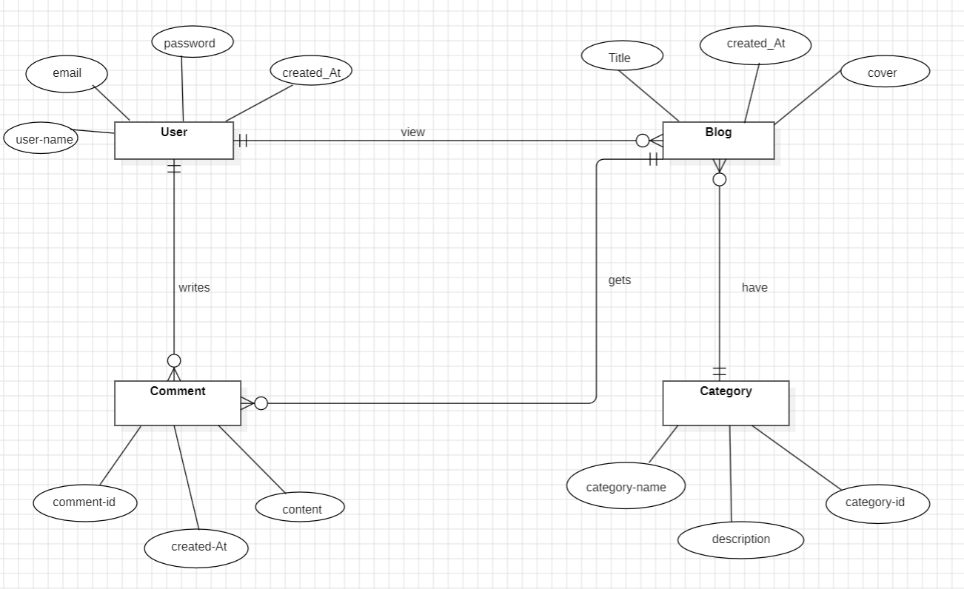
Entity-Relationship Diagram

Slide 6
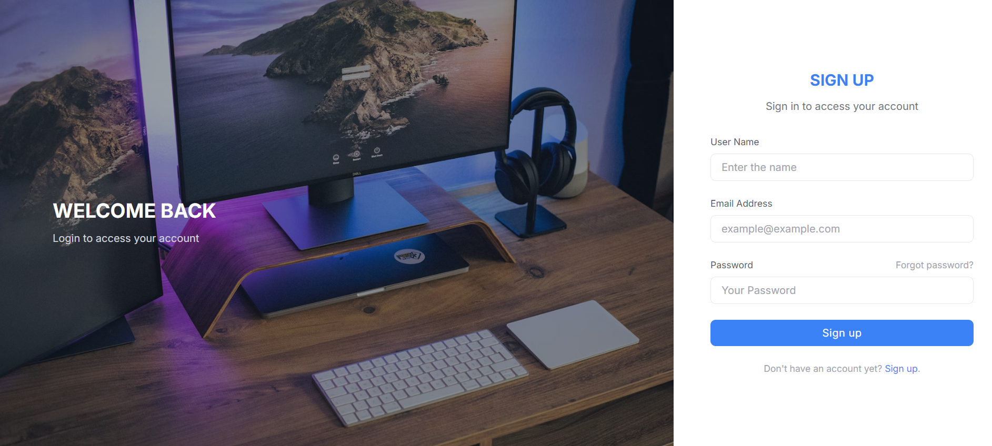
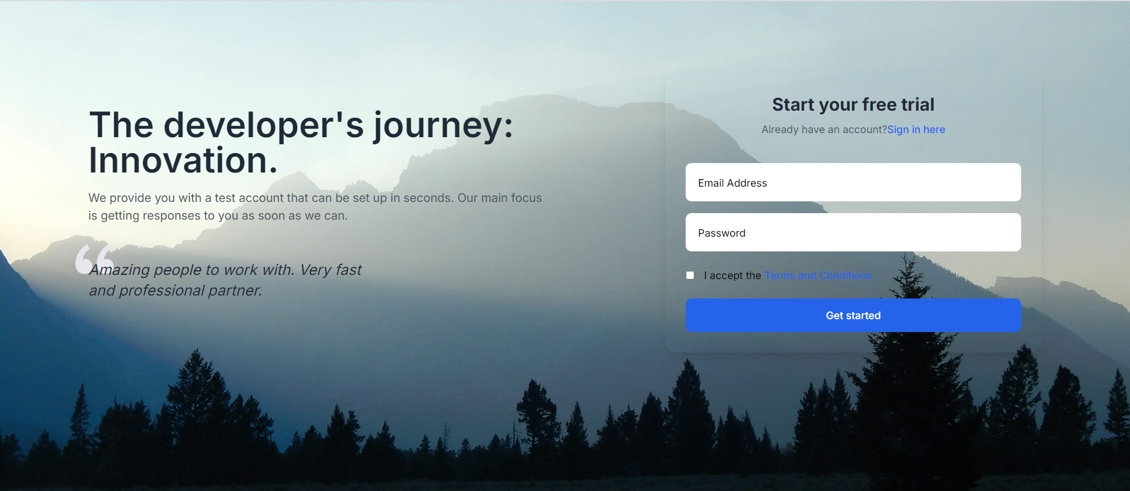
Signup and login page

Slide 7
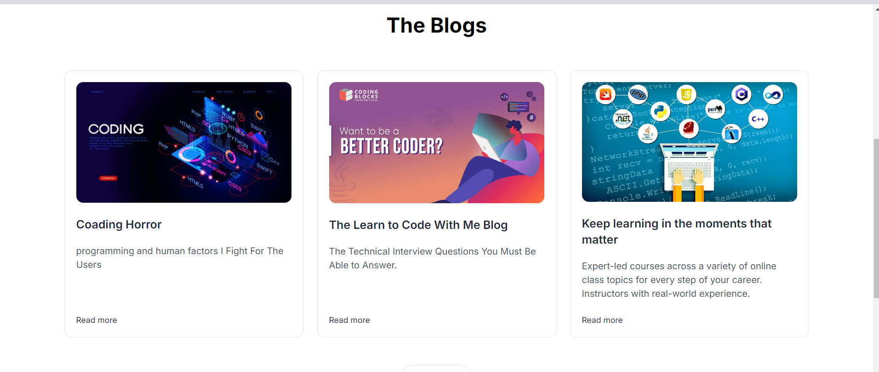
Home page

Slide 8
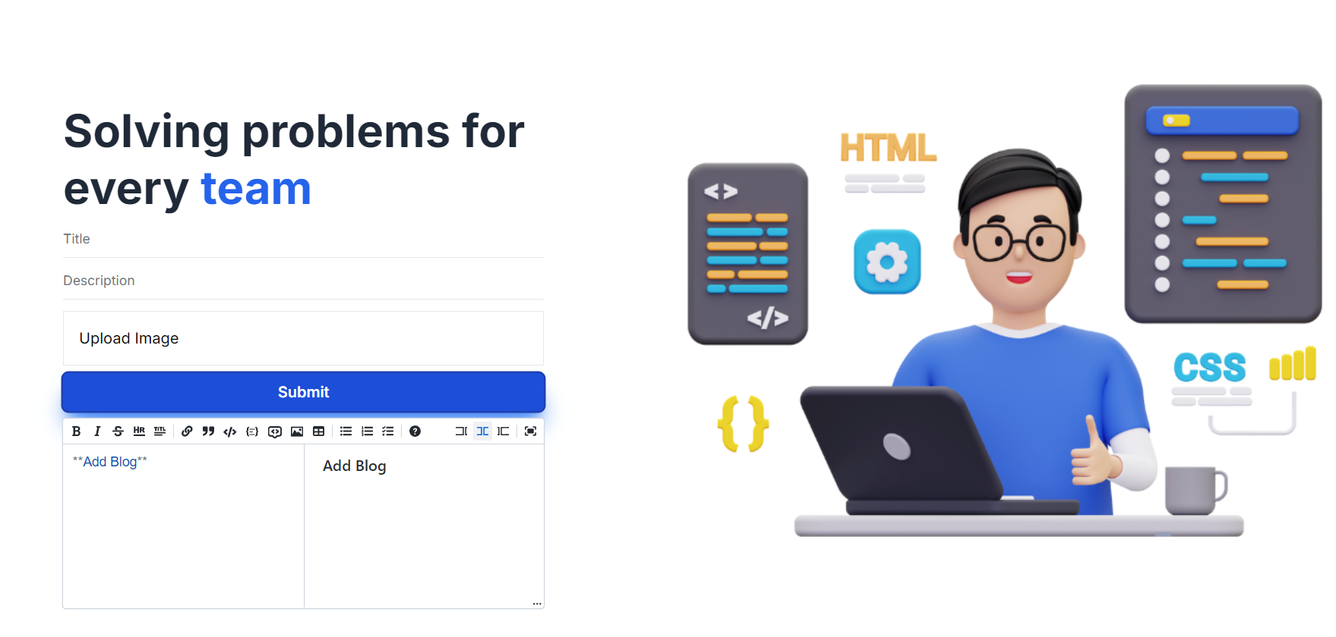
Create Blog Page

Slide 9
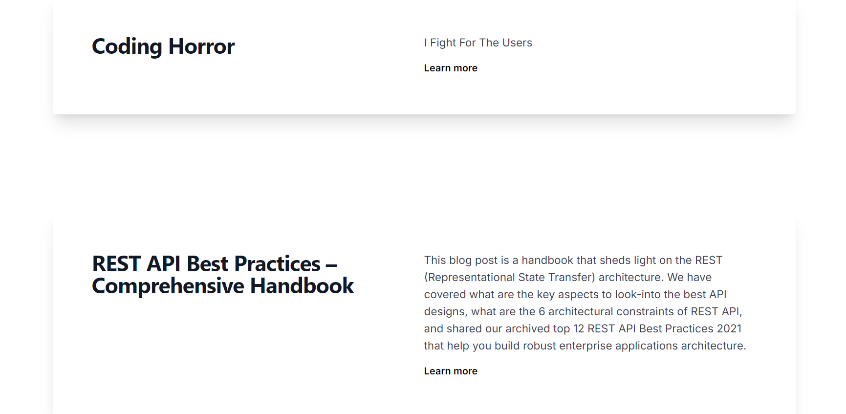
Blog listing Page

Slide 10
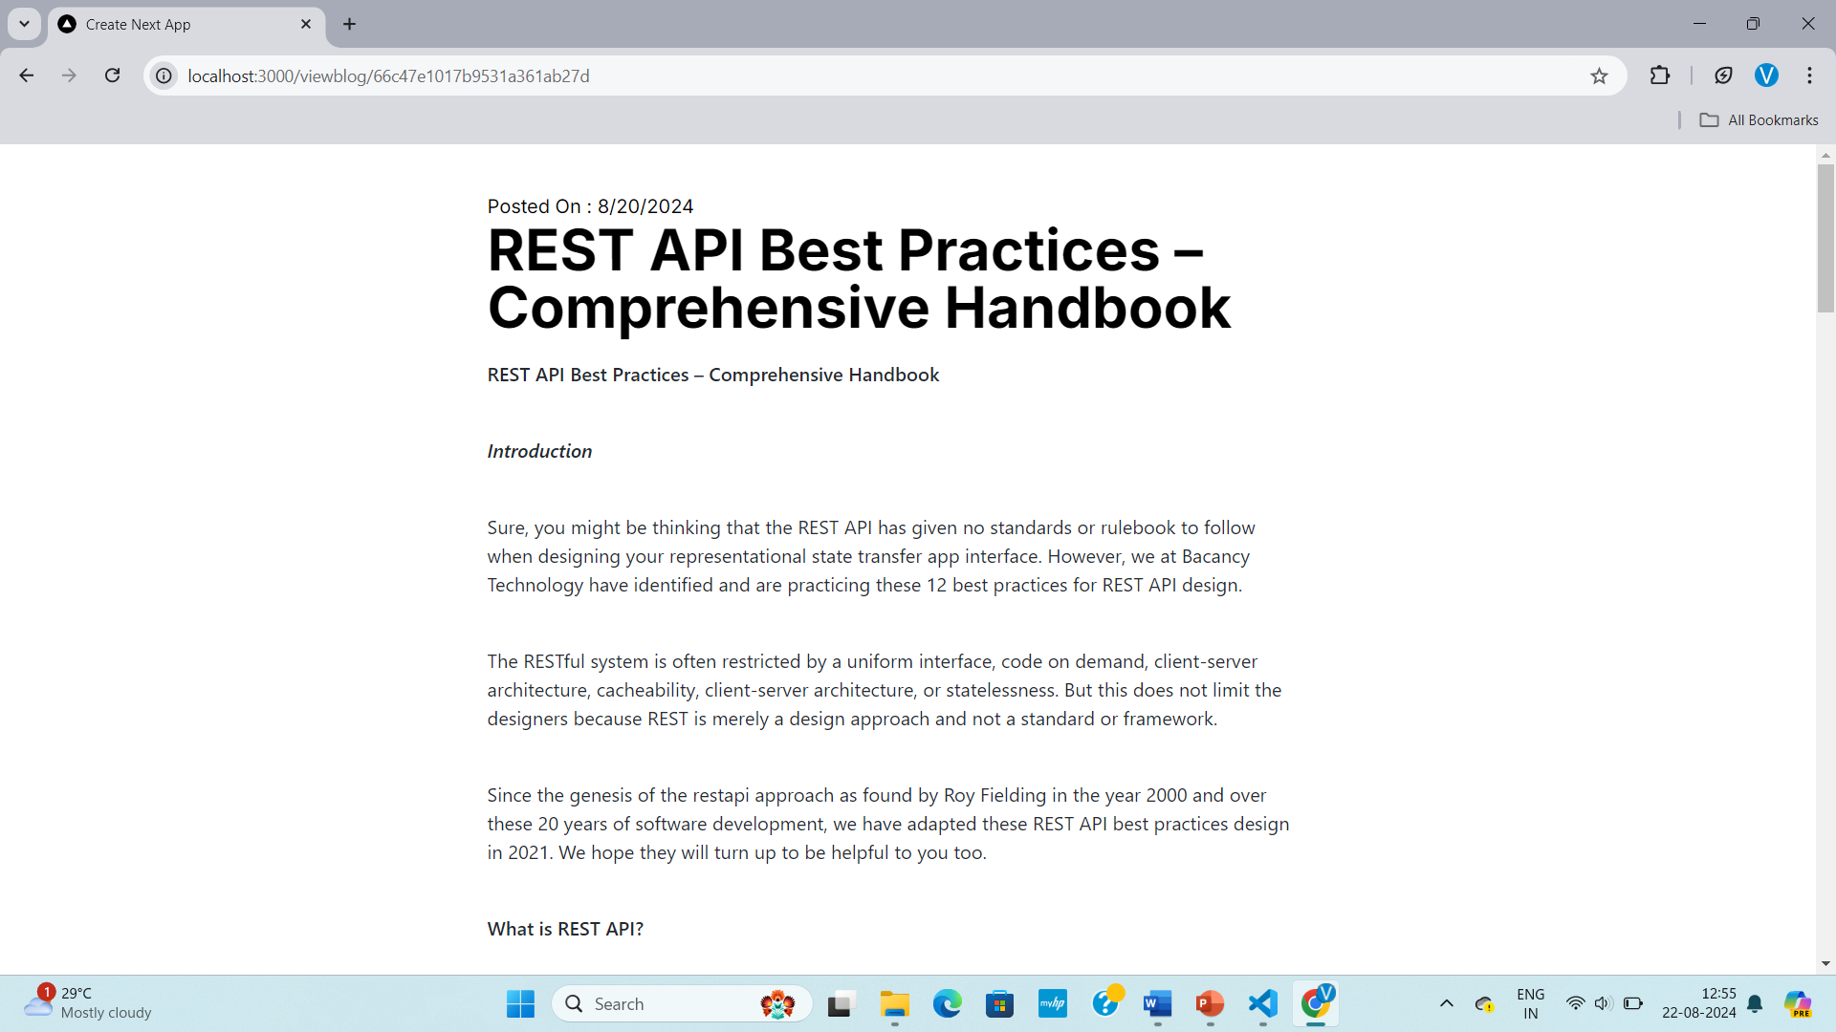
View blog page

Slide 11
thank you
VANSHIKA PAL
BCA Semester-5
Roll no:2211831010047

